Slide 1
IMS Project
Syed Shakir Ali

Slide 2

Introduction
I joined QA with no previous experience in this field and have learnt everything during the first 5 weeks of training. Training was difficult at times as everything was new content to me and took time to digest. However, I really enjoyed working on my first project as I was able to challenge myself and combine all the skills I have acquired over the first 5 weeks
I faced difficulties during the project but I feel like I have improved a lot and I can see what went well and which areas I can improve in for any future projects.

Slide 3
Consultant Journey
Version Control System: Git
Source Code Management: GitHub
Scrum Board: Jira
Database Management System: MySQL Server 5.7+ (local or GCP instance)
Back-End Programming Language: Java
Build Tool: Maven
Unit Testing: Junit & Mockito
I have learnt about several different technologies throughout my first 5 weeks. They were all required in this project for different reasons.

Slide 4
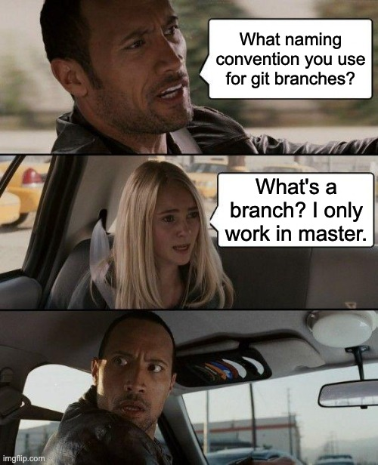
Version Control
Version control – Git
Using the Feature Branch Model
Main -> Dev -> Feature
Working in feature branch
Pushing to GitHub and then merging with Dev branch when I was happy with my work
I improved in using Git and I am more confident now

Slide 5
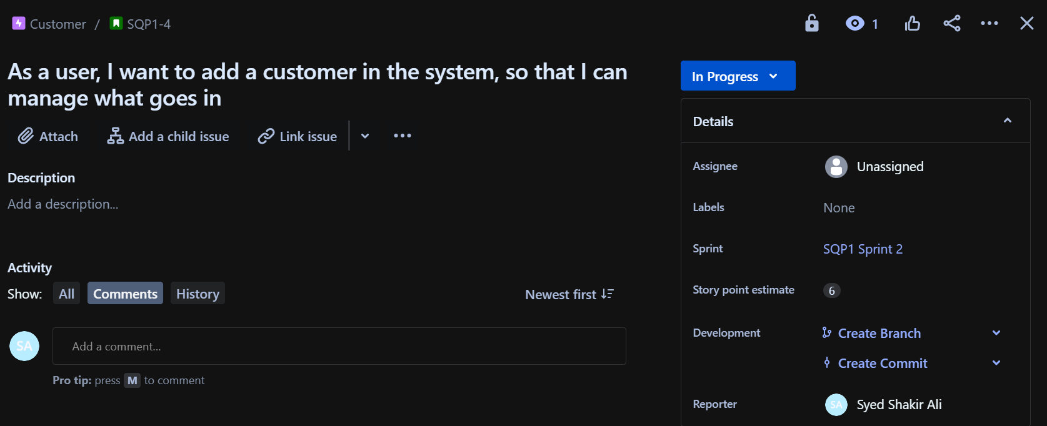
Jira
Scrum Board – Jira
I broke down the project into smaller, manageable tasks and these became my user stories in Jira Scrum Board
User stories were given a story point estimate (based on how labour intensive they would be) and assigned to an epic. Some user stories also had child issues assigned to them
I had 4 epics. Documentation, Customer, Item and Order
Initial sprint was a daily sprint for documentation
Acceptance Criteria and smart commits and Fibonacci

Slide 6
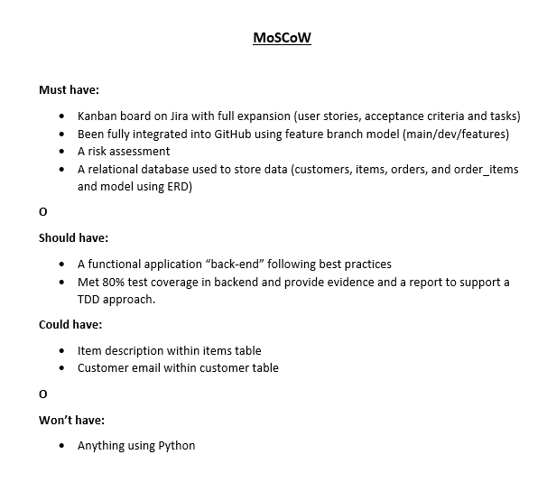
MoSCoW

Slide 7
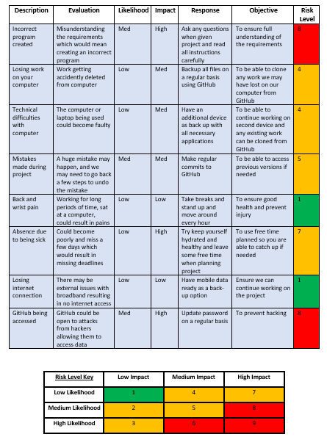
Risk Assessment
Risk Assessment with 8 risks
Created a key to indicate risk level
Key was created using likelihood and impact
Used a colour scheme in key to visually show risk level

Slide 8
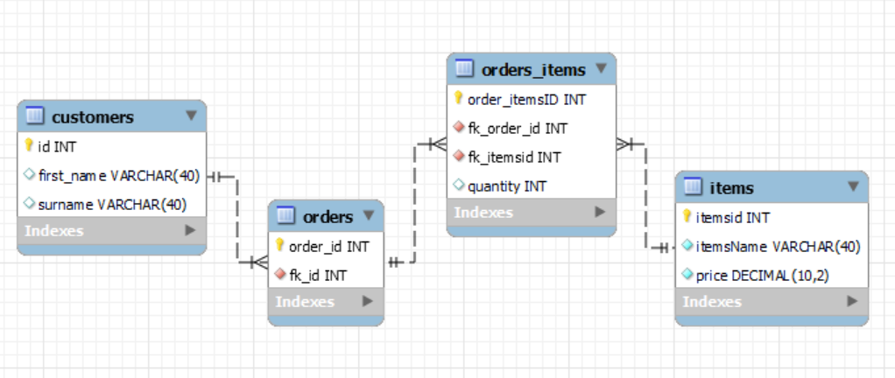
Entity Relationship Diagram
Created an initial ERD by hand but will redo online
Final ERD is on the screen
MySQL does not support direct many-to-many relationships between tables
Extra table to split a many-to-many relationship into two one-to-many relationships

Slide 9
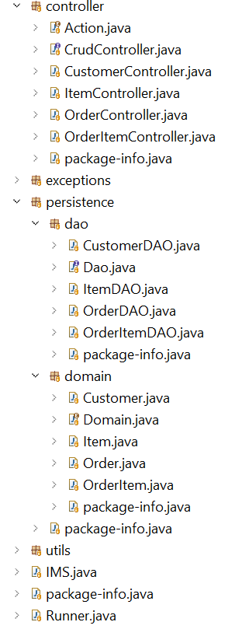
CRUD
CRUD functionality created
They meet the MVP requirements
Fulfil user stories
Tried all function out and they all worked
Testing still in progress

Slide 10
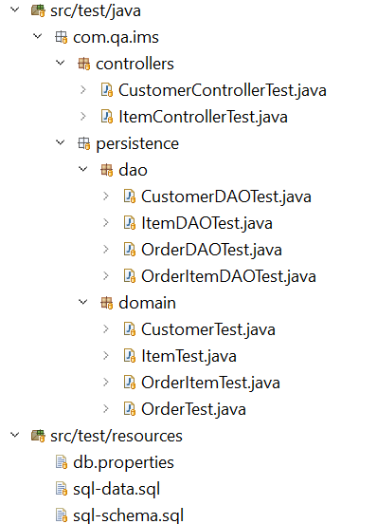
Testing
I am still working on testing
I have completed all domain tests and they all pass with no errors
I have completed all DAO tests but there are some issues in ItemDAO and OrderItemDAO that I am currently working on
Still working on controller test but CustomerControllerTest and ItemControllerTest are complete and both are passing fine with no errors.

Slide 11
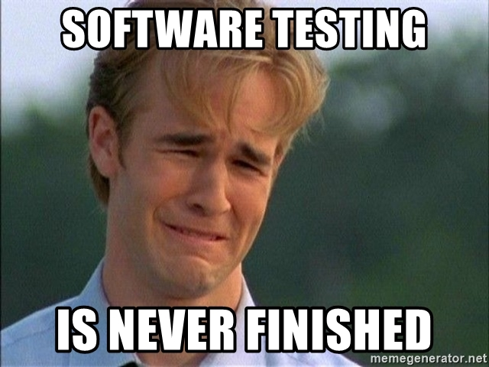
Conclusion
I enjoyed working on the project and it was beneficial in solidifying my knowledge and skills.
Use of feature branches
Smart commits and acceptance criteria and sprints
UML diagram
Read.me
Initial ERD
Fat.jar
.pdf format for risk assessment and MoSCoW
.png format for ERD and UML
Finish testing

